Slide 1
Agentic AI Architecture (The Future of Intelligent Systems)
Exploring the Power of Autonomous, Adaptive, and Context-Aware AI

Slide 2

Agentic AI Architecture
Rakesh Kumar
Linked In : linkedin.com/in/rakesh-jaiswal-91bb60b
We will run through evolution and architecture of Agentic AI followed by a Demo
Disclaimer:
The views and opinions expressed in this presentation are solely my own and do not reflect the views or opinions of my employer or any clients I work with.

Slide 3
Software 1.0
Data
X
CPU
Y
F(X)
Desired Behaviour
Human Coding
Software 2.0
Un-known Data
Data
X
GPU
X’
GPU
Y’
Desired behaviour
Y
F(x)
Un-known Behaviour
Machine Learning
Model Inferencing

Slide 4
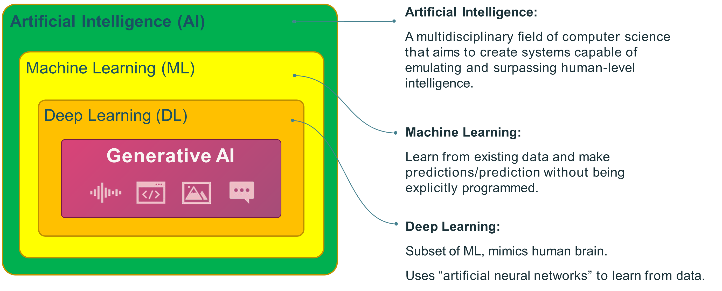
Background

Slide 5


Background
Artificial Intelligence (AI)
Generative Artificial Intelligence:
Sub-field of AI that focuses on
generating new content such as:
Images
Text
Audio/music
Video
Code
3D objects
Synthetic data
Machine Learning (ML)
Deep Learning (DL)
Generative AI

Slide 6
Background
Artificial Intelligence (AI)
Agentic AI:
AI Systems that are designed to autonomously make decisions and act with the ability to pursue complex goals with limited supervision.
Machine Learning (ML)
Deep Learning (DL)
Generative AI
Agentic AI

Slide 7
Evolution of LLM & Agent
Phase 1: Simple Model (Basic Input-Output)
Early AI Models were limited to basic input output mapping.
These models had predefined responses and lacked context awareness.
Example: Rule-based chatbots, simple neural n/w.
Phase 2: Very Large Context windows
Transformer based model with extensive context windows.
Enabled more coherent and contextual responses over larger input sequences.
Example: GPT-4 with up to 128k token context
Phase 3: Retrieval-Augmented Generation (RAG)
Combines pre-trained models with external knowledge retrieval.
Responses with real-time, accurate information from databases or the web.
Example: Hybrid AI search engines, AI-assisted research tools

Slide 8
How does a LLM understand language?
The moon, Earth's only natural satellite, has been a subject of fascination and wonder for thousands of years.
Encode
Language
976, 28479, 11, 146677, 1606, 6247, 36703, 11, 853, 1339, 261, 5401, 328, 110310, 326, 6213, 395, 13369, 328, 2101, 13
Token
Generate
That's a great opening sentence! It effectively sets the stage for a discussion about the moon's significance and allure.
Output

Slide 9
How does it Encode and Generate?
The moon, Earth's only natural satellite, has been a subject of fascination and wonder for thousands of years.
Encode
Language
976, 28479, 11, 146677, 1606, 6247, 36703, 11, 853, 1339, 261, 5401, 328, 110310, 326, 6213, 395, 13369, 328, 2101, 13
Tocken
Generate
That's a great opening sentence! It effectively sets the stage for a discussion about the moon's significance and allure.
Output
Big Data
Big Compute
Train the Model

Slide 10
The Typical GenAI Journey
Prompt Engineering
Retrieval Augmented Generation (RAG) + Agents
Fine-tuning
Pre-training
More control and customization, but more compute and complexity

Slide 11
The Typical GenAI Journey
Prompt Engineering
Retrieval Augmented Generation (RAG) + Agents
Fine-tuning
Pre-training
Current Industry Trends
More control and customization, but more compute and complexity

Slide 12
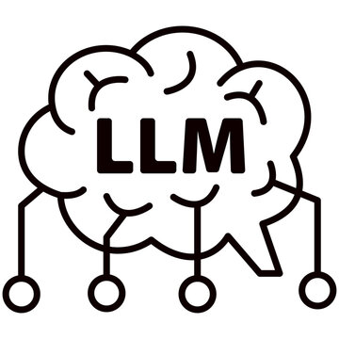
How Prompting Evolved
Prompting 01
Typical LLM App Prompting
Advanced App Logic
User Input
User Input
User Input
Prompt Template 1 & Response
System Message
Example Logic
Answer Sample
Prompt Template 1 & Response
User Input
Response
Prompt Template
Prompt Template 1 & Response
Response
Response

Slide 13
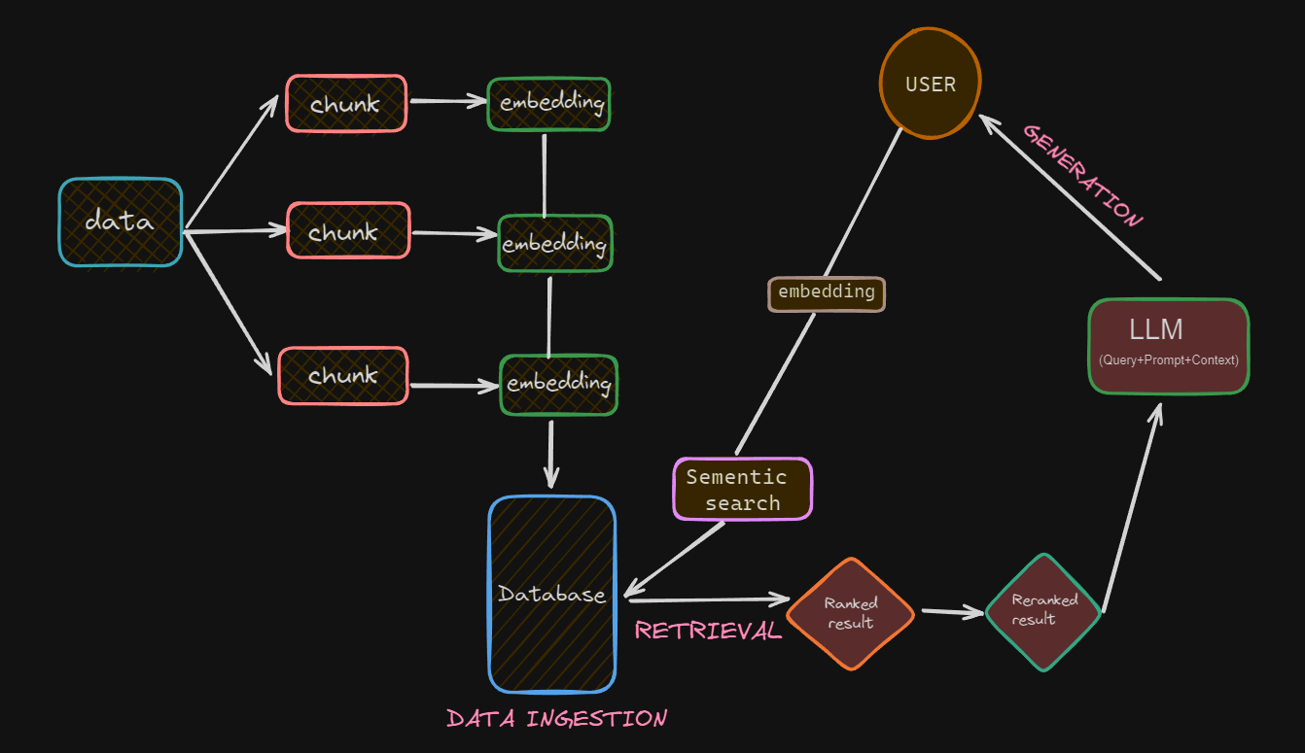
RAG

Slide 14
Evolution of LLM & Agent
Phase 4: Multimodal AI Models
Ability to process and generate text, images, audio, and video.
Expands AI applications into creative, analytical, and assistive domains
Example: GPT-4V (Vision)
Phase 5: Reasoning AI Models
Capable of Complex Problem solving and logical reasoning.
Improved decision-making, planning and dynamic response generation
Example: Chain-of-thought prompting, AI-driven logic engines
Phase 6: AI Agents
AI system that can plan, execute and refine task autonomously
Includes memory, reasoning and self improvement mechanisms
Example: Robotics system

Slide 15
AI Agent
Planning
Memory
Agentic AI:
AI agents are autonomous systems that interact with users and its environment to make decisions and complete tasks.
Goal
Agent
Tools
Actions
Environments
Other Agents

Slide 16

An AI Agent (Architecture)
Prompt Template
Planning
Reasoning
Prompt
Agent
LLM
Response
Action
Store/Retrieve
Tools
Memory

Slide 17
An AI Agent (Execution)
Agent Runtime
Orchestration
Tools
Profile, goal, & instructions
Query
Memory, sort-term, long-term
Model based Reasoning/Planning
Model
Agent Response

Slide 18
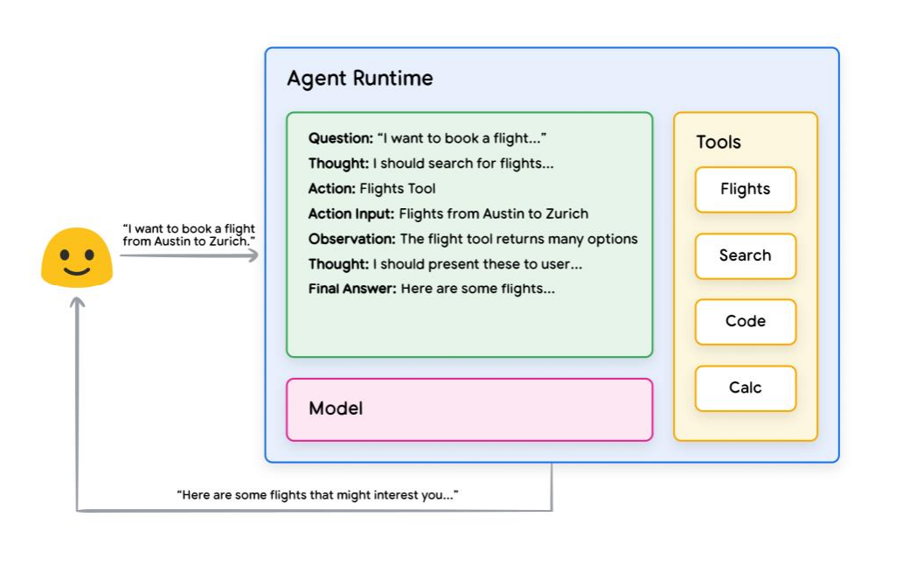
ReAct reasoning example

Slide 19
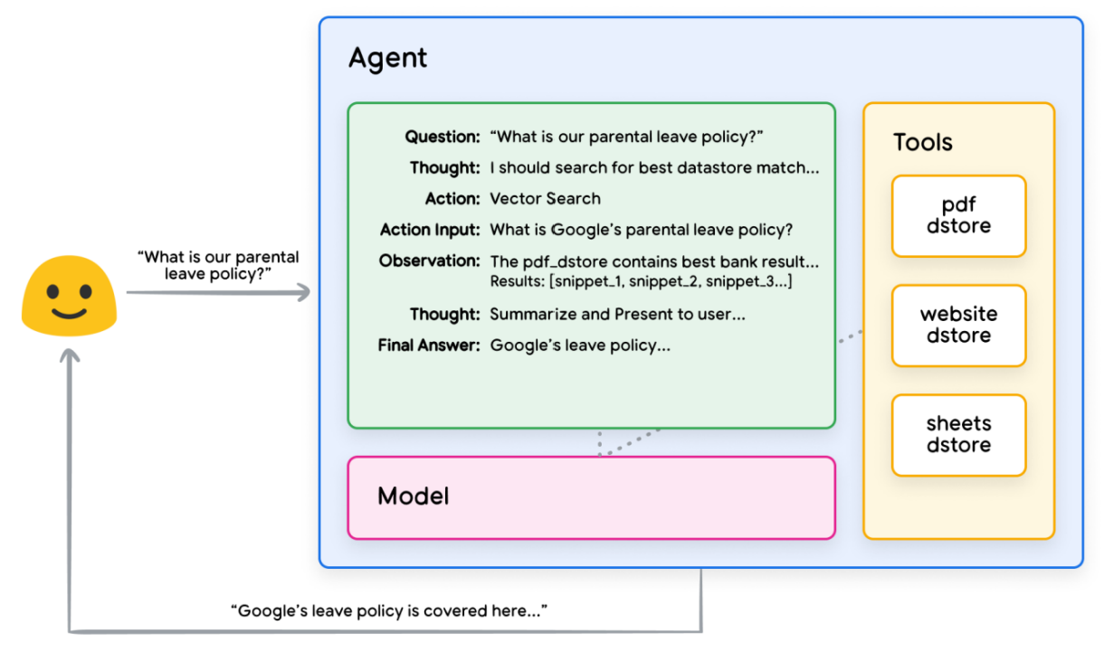
Sample RAG based ReAct example

Slide 20
From Simple Assistant-->RAG--> AI Agent Challenges?
Slower development, more effort, higher cost, slower deployments.
(prompt engineering, fine-tuning, data handling, and deployment)
Poor Retrieval & Context Handling
(handling long documents, knowledge bases, or user queries becomes inefficient)
Lack of Scalability
(memory management, batching, and distributed computing)
Higher Security & Compliance Risks
(implementing audit logs, bias control, and output moderation is challenging.)
Solution:
We need Frameworks & Tools

Slide 21





Frameworks & Tools
 | Framework for chaining of LLMs with other data sources and API
 | To visualize and graph-based workflows for AI models
 | Support in data ingestion, structuring, retrieval, and integration
 | Multi-Agent Platform
AutoGen | MS Open Source, to build multi-agent system
Amazon Bedrock | For building and scaling generative AI applications.
PhiData | Build agents and workflows to automate intelligent work.
 | Low-code to build AI-Agent and workflow

Slide 22
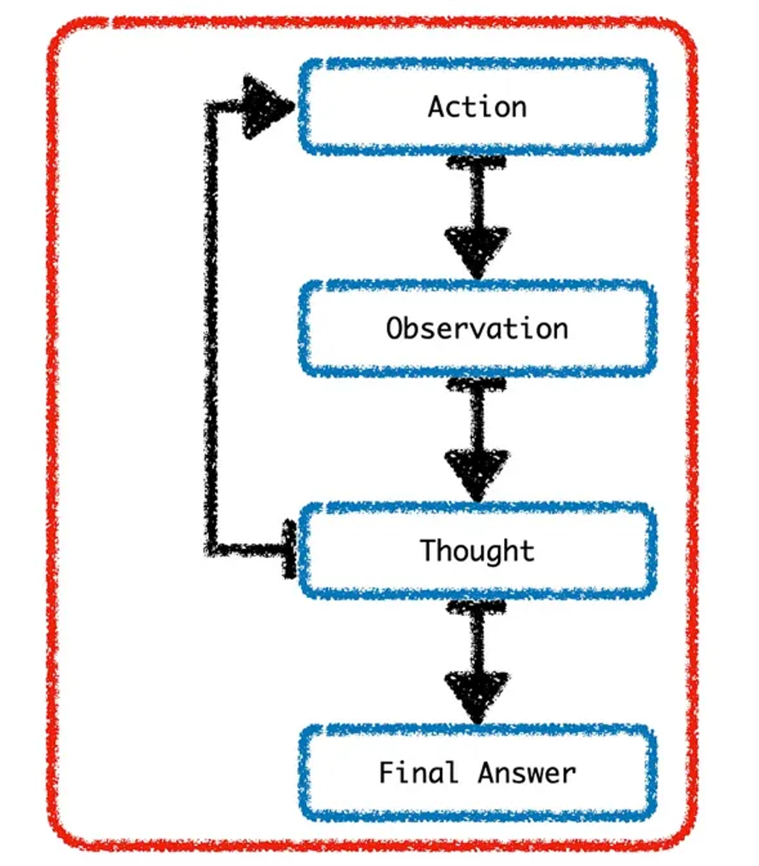
LangChain Agent – Sequence of Events

Slide 23
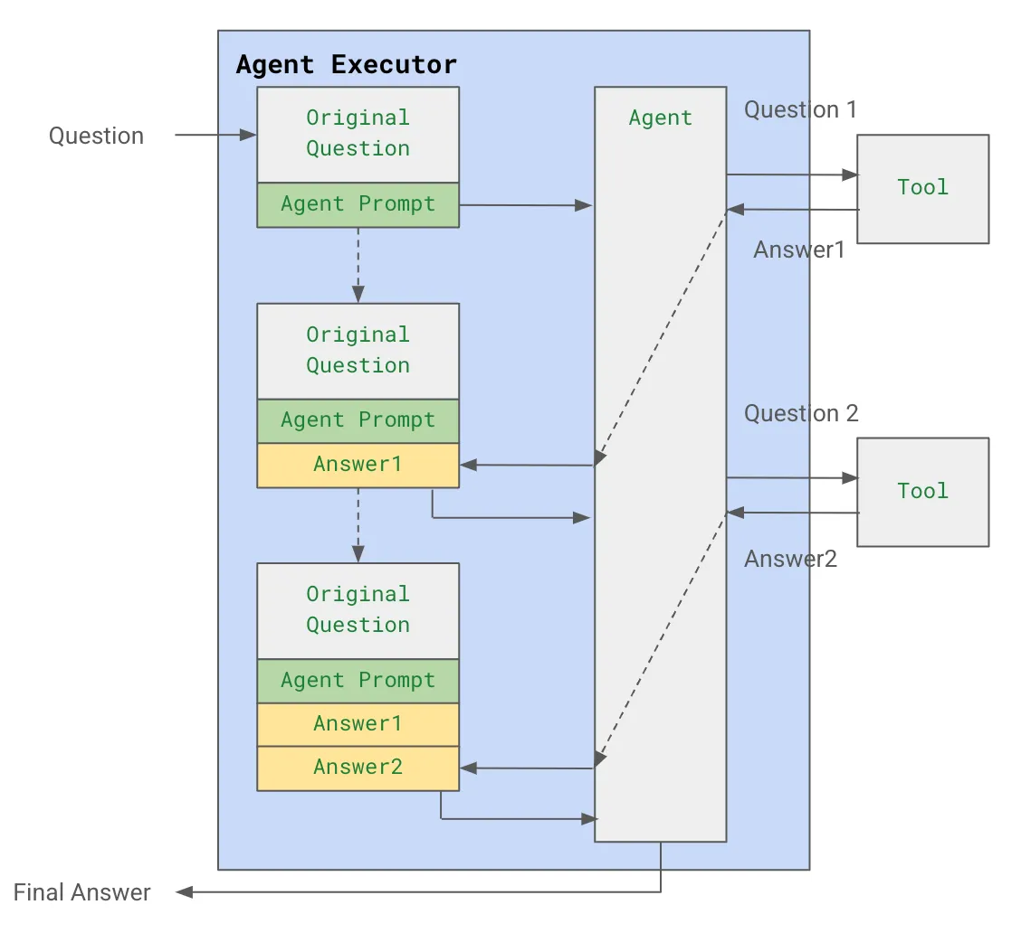
LangChain Agent – Sequence of Events

Slide 24
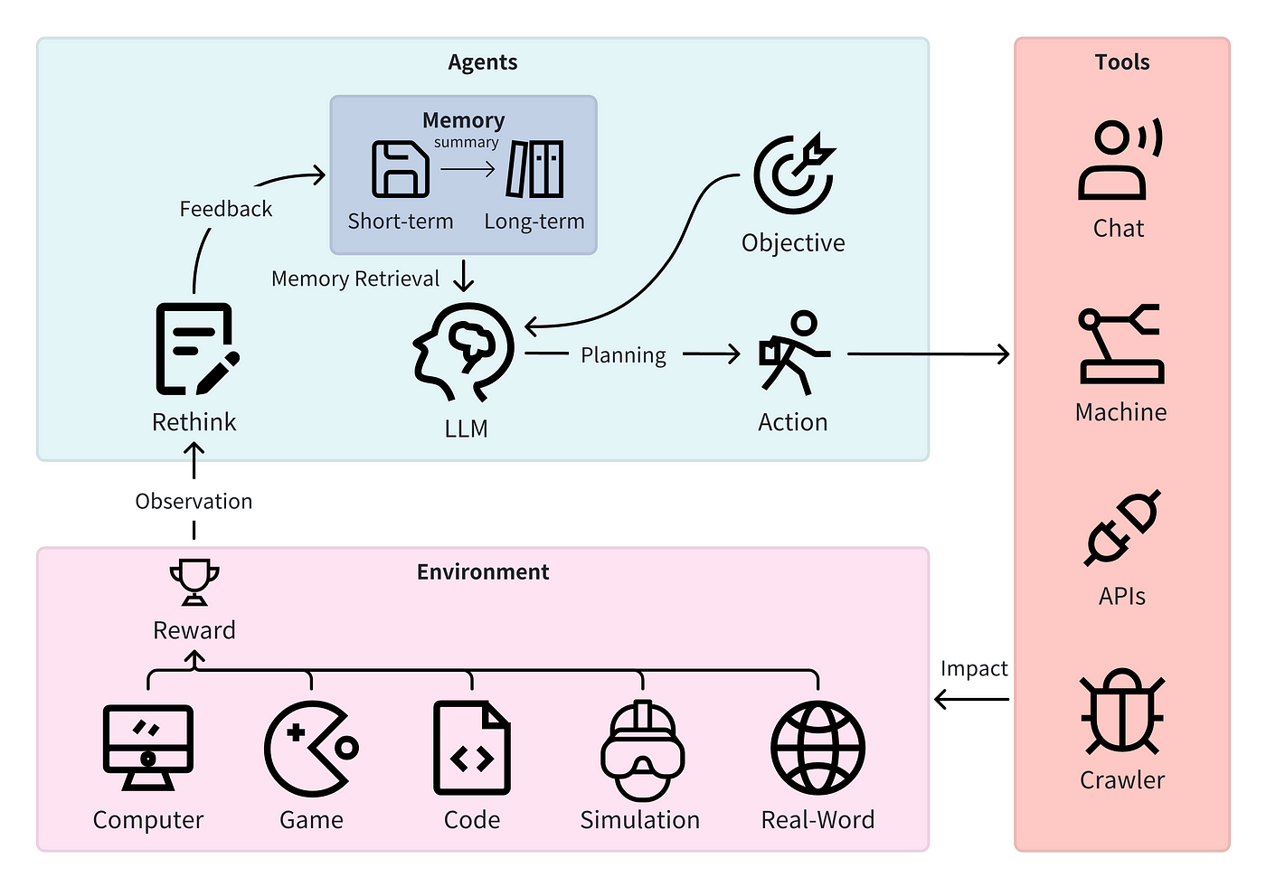
Multi Agent System Architecture

Slide 25
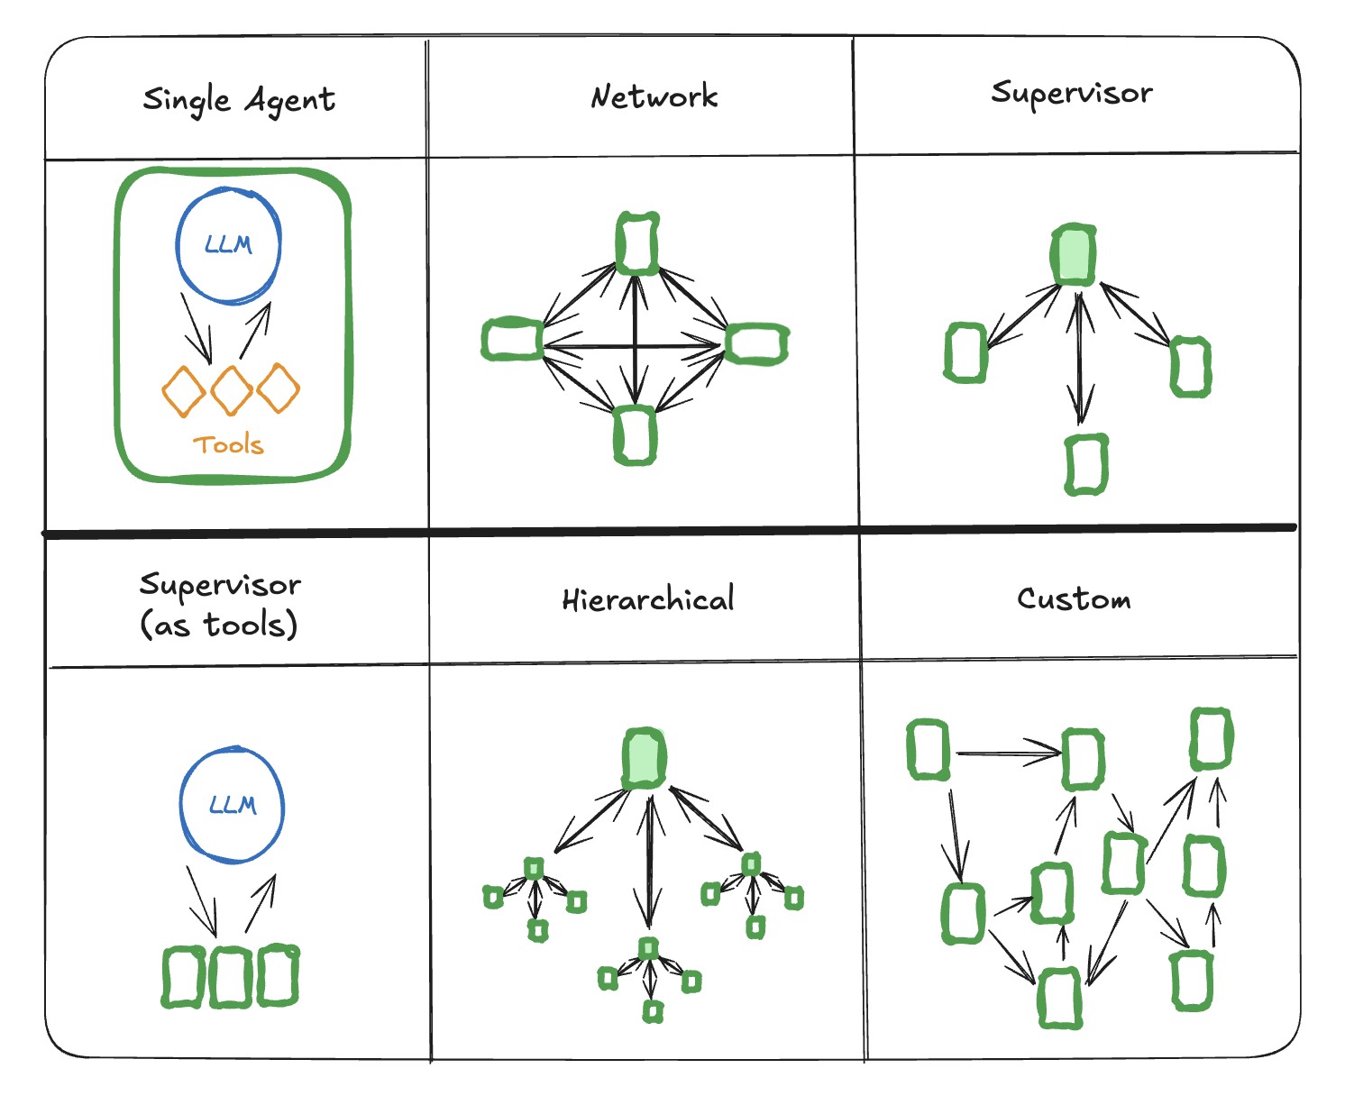
Multi Agent Architecture

Slide 26
Demo

Slide 27



Thank You!
LinkedIn
YouTube Channel
WhatsApp Group

Slide 29
References
Top 7 Frameworks for Building AI Agents in 2025
LangChain
LangGraph
Introduction – Phidata
CrewAI
Products - Groq is Fast AI Inference

